Slide 1
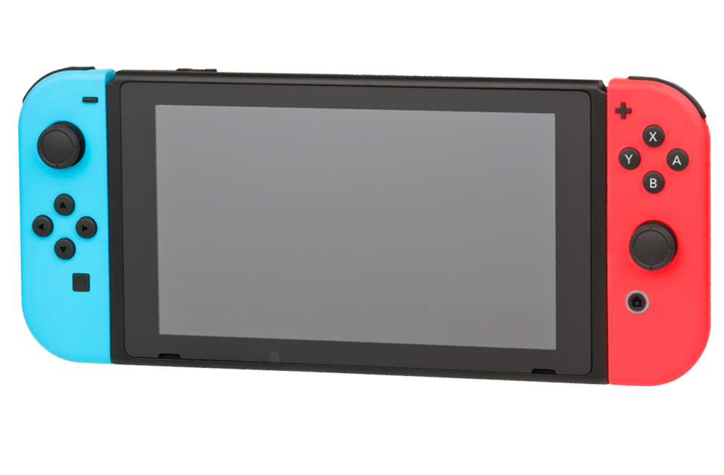



Game On
Video game suggestion Program
Programmed by Kyle Kelley

